Slide 1

VALLURUPALLI NAGESWARA RAO VIGNANA JYOTHI INSTITUTE OF ENGINEERING AND TECHNOLOGY
Department of Computer Science and Engineering
MACHINE LEARNING
Dr. Kriti Ohri
Assistant Professor
Department of Computer Science and Engineering

Slide 2
Machine Learning Types

Slide 3
Machine Learning Types
A machine can learn to solve a problem by following any one of the following three approaches. These are the ways in which a machine can learn:
Supervised Learning
Unsupervised Learning
Reinforcement Learning

Slide 4
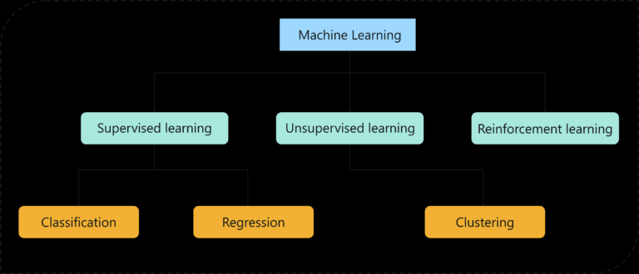
Types of Machine Learning algorithms

Slide 5
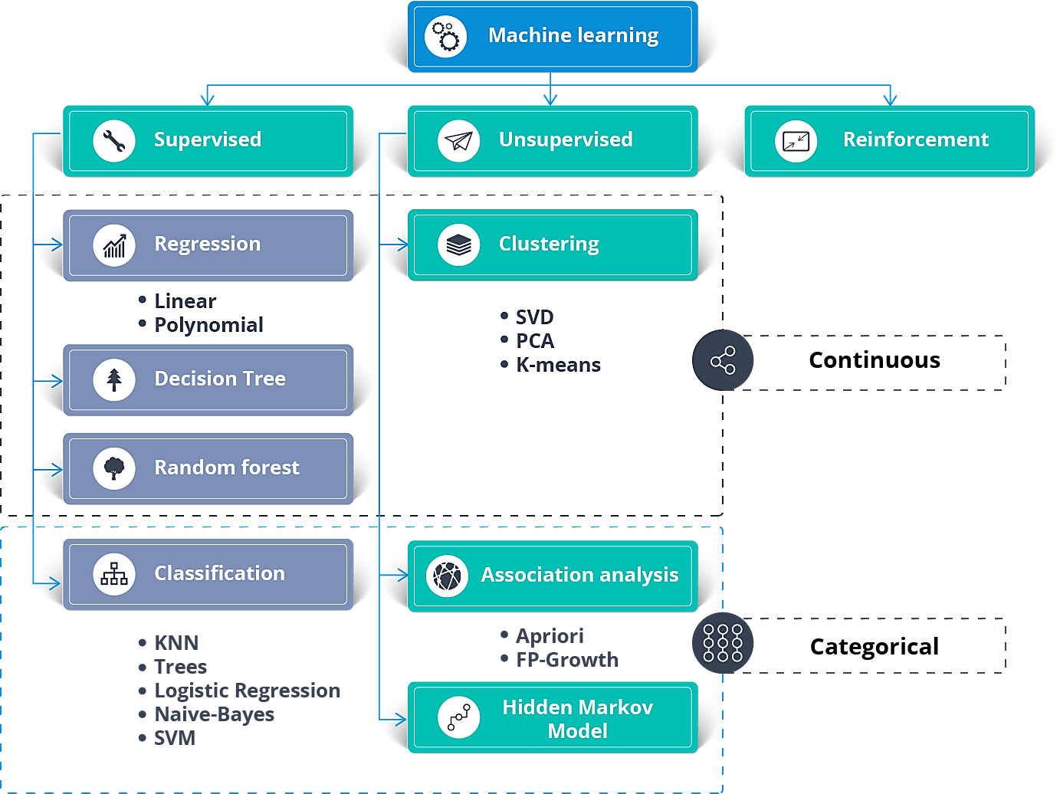
Machine Learning Algorithms: What are the types of Machine Learning Algorithms?

Slide 6
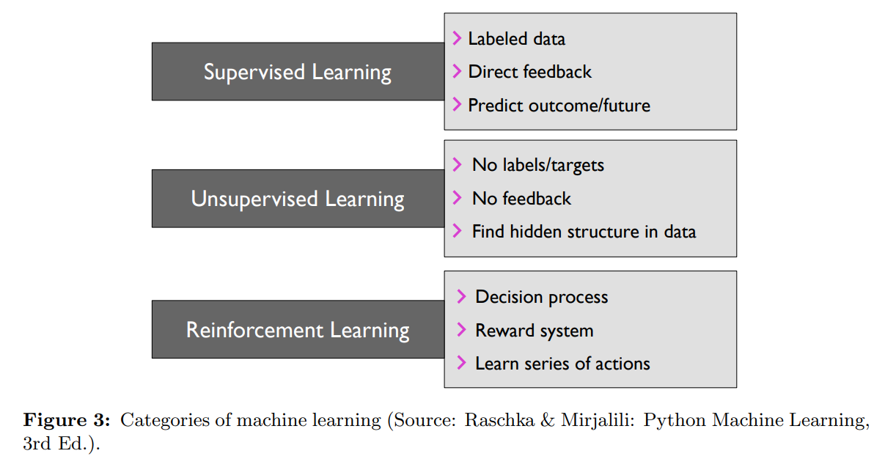
Types of machine learning algorithms

Slide 7
Feature values
To describe the instance features play a very important role
Often the individual observations are analyzed into a set of quantifiable properties which are called features. May be-
Categorical(e.g. “A”, “B”, “AB”, or “O” -Blood groups)
Ordinal(e.g. Large, medium, or small)
Integer-valued(e.g. The number of words in a text)

Slide 8
1. Supervised Learning
Supervised learning is a technique in which we teach or train the machine using data which is well labeled.
To understand Supervised Learning let’s consider an analogy. As kids we all needed guidance to solve math problems. Our teachers helped us understand what addition is and how it is done. Similarly, you can think of supervised learning as a type of Machine Learning that involves a guide. The labeled data set is the teacher that will train you to understand patterns in the data. The labeled data set is nothing but the training data set.

Slide 9
Supervised Learning
Supervised learning is the subcategory of machine learning that focuses on learning a classification, or regression model that is, learning from labeled training data (i.e., inputs that also contain the desired outputs or targets; basically, “examples” of what we want to predict).
To understand Supervised Learning let’s consider an analogy. As kids we all needed guidance to solve math problems. Our teachers helped us understand what addition is and how it is done. Similarly, you can think of supervised learning as a type of Machine Learning that involves a guide. The labeled data set is the teacher that will train you to understand patterns in the data. The labeled data set is nothing but the training data set.

Slide 10
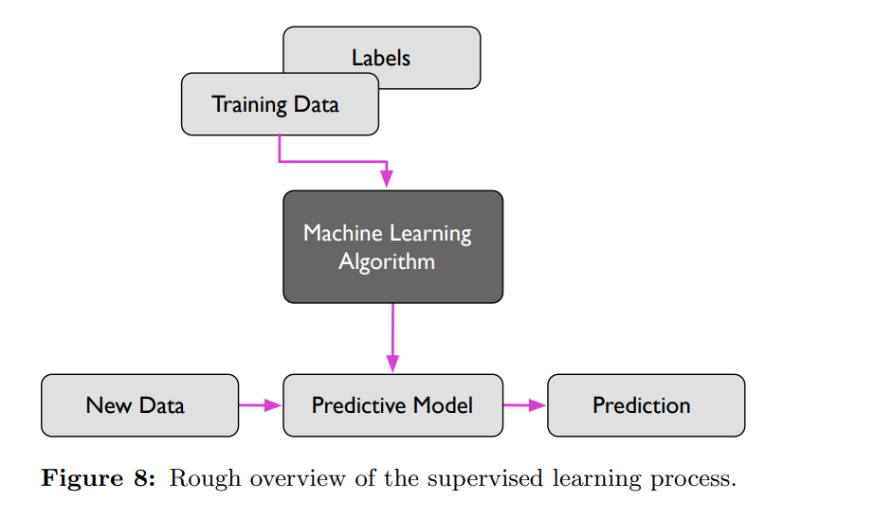
Supervised learning or label learning

Slide 11
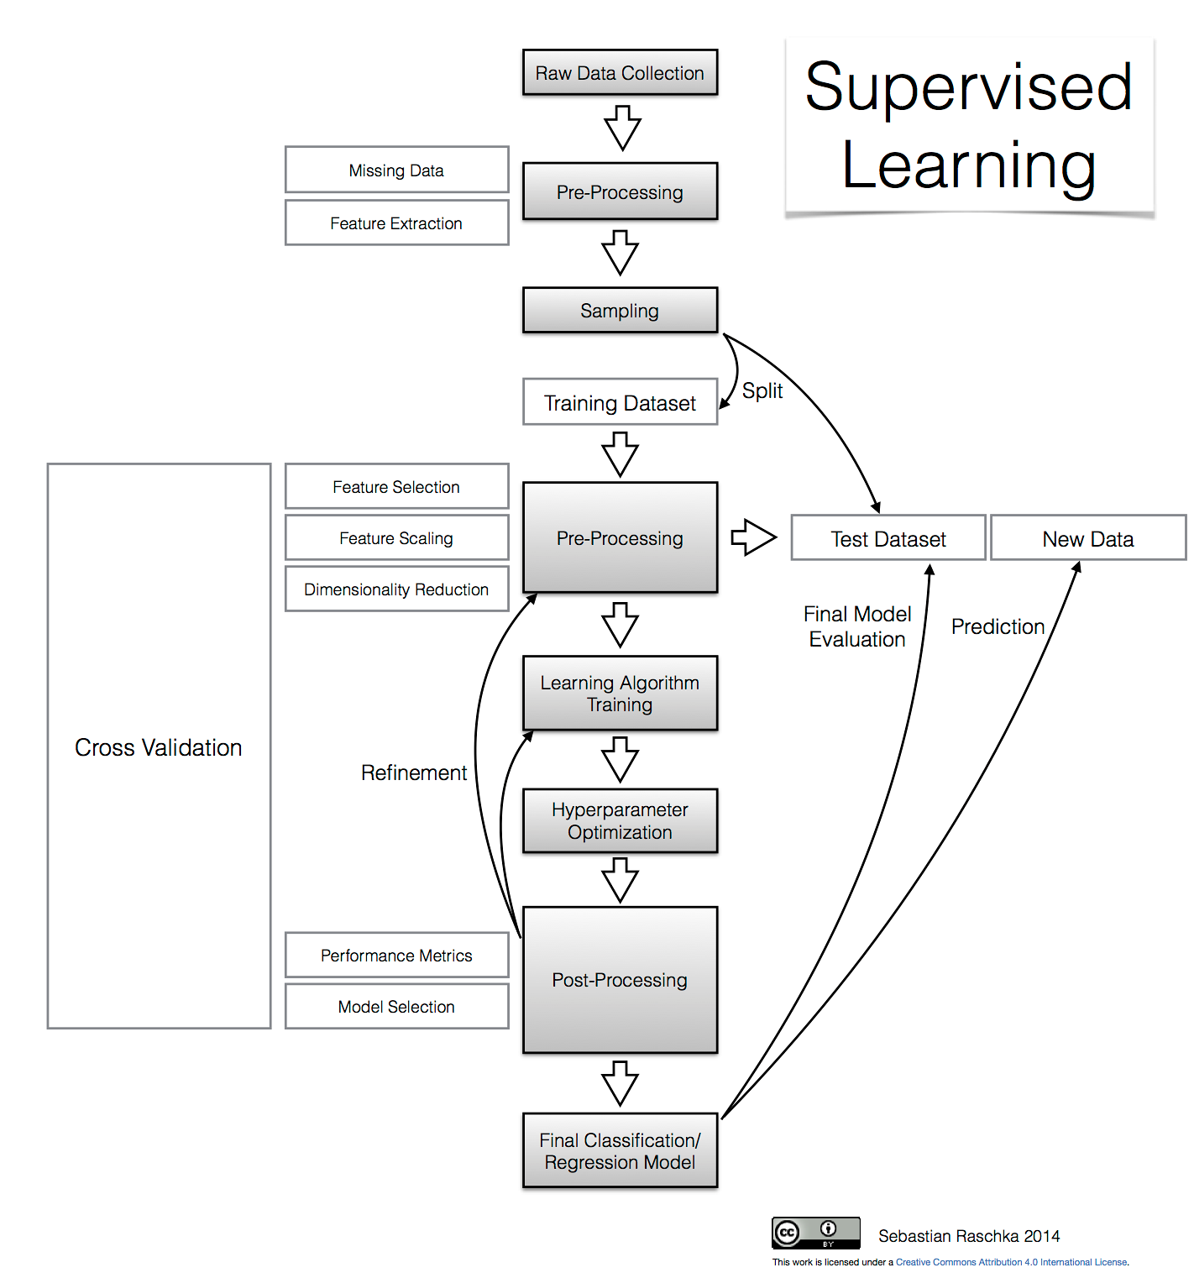

Slide 12
Supervised learning
X1 X2 …... Xn Y (discrete or continuous attribute label)
Instance 1 a1 a2 …... an y1
Instance 2 b1 b2 …... bn y2
Instance 3 c1 c2 …... cn y3
test instance
z1,z2,..zn ……………………………………………………………………?
Discrete feature -if it will rain or not tomorrow /or if the patient have a particular disease (classification problem)
Continuous feature- predict the price of house (regression problem)

Slide 13
Supervised learning can be categorized into two major subcategories: regression analysis and classification. In regression analysis, the target values or labels are continuous variables. In classification, the labels are so-called class labels, which can be understood as discrete class- or group-membership indicators.

Slide 14
Supervised Learning Types
Supervised Learning
Classification
Regression
Supervised learning task with discrete class labels/ unordered,
Eg. Email spam detection, if a mail is spam or not (binary class classification task), however you can also have multi class classification task ( Handwriting character recognition)
Supervised learning task with continuous class labels.
Eg. Predicting house price.
Prediction of temperature

Slide 15
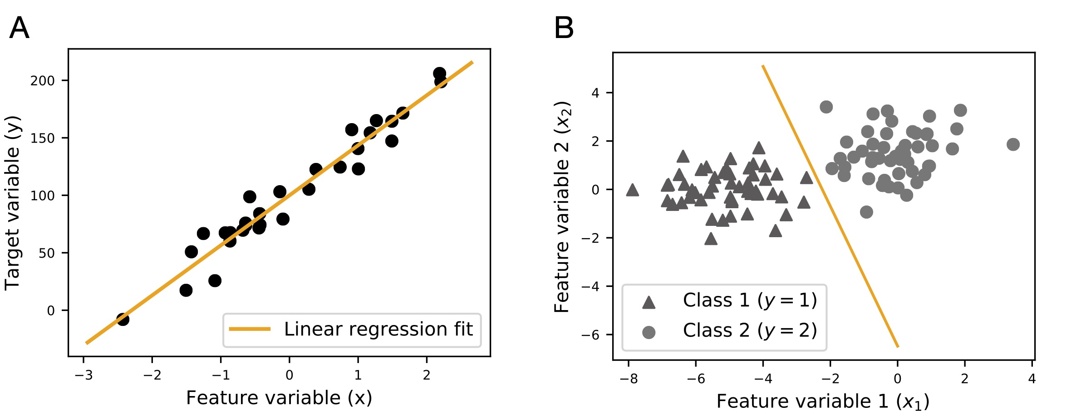
Illustrations of the two main categories of supervised learning, regression (A) and classification (B).

Slide 16
Classification Learning
Task T:
-input: a set of instances d1, d2, ….,dn
An instance has a set of features
We can represent an instances as a vector d=<x1, x2,….xn>
-Output: a set of predictions
One of a fixed set of constant values:
Eg. (+1, -1) or (cancer, healthy) or (rose, lily)
Performance metric P
Experience E

Slide 17
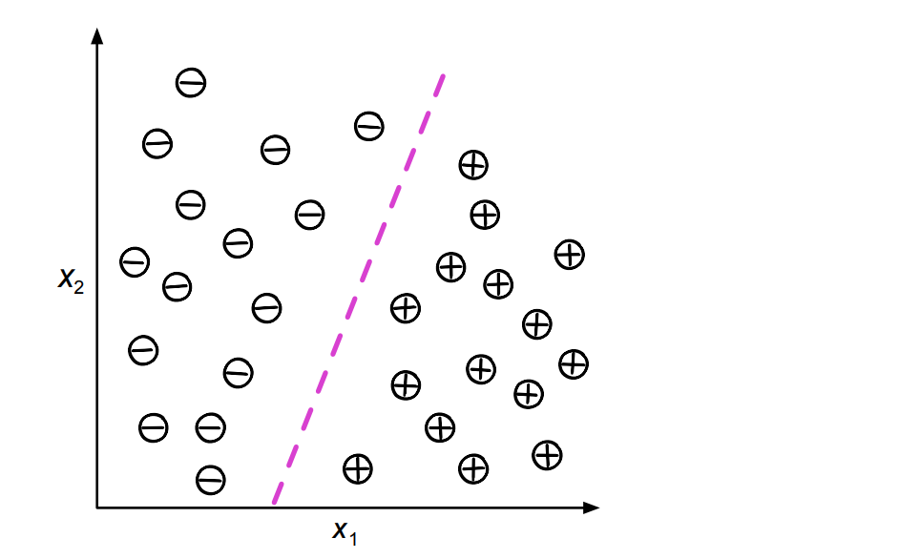
Classification
Illustration of a binary classification problem (plus and minus signs denote class labels)
and two feature variables, (x1 and x2).

Slide 18
Classification is a type of supervised learning problem
We use the training dataset to get better boundary conditions which could be used to determine each target class. Once the boundary conditions are determined, the next task is to predict the target class. The whole process is known as classification.

Slide 19
Analysis of the customer data to predict whether he will buy computer accessories (Target class: Yes or No) Classifying fruits from features like color, taste, size, weight (Target classes: Apple, Orange, Cherry, Banana) Gender classification from hair length (Target classes: Male or Female)
Target class examples:

Slide 20
Classification Algorithms category
Binary Classification: Classification task with two possible outcomes. Eg: Gender classification (Male / Female)
Multi-class classification: Classification with more than two classes. In multi-class classification, each sample is assigned to one and only one target label. Eg: An animal can be a cat or dog but not both at the same time.

Slide 21
Applications of Classification Algorithms
Email spam classification
Bank customers loan pay willingness prediction.
Cancer tumor cells identification.
Sentiment analysis
Notes:
malignant" and "benign"

Slide 22
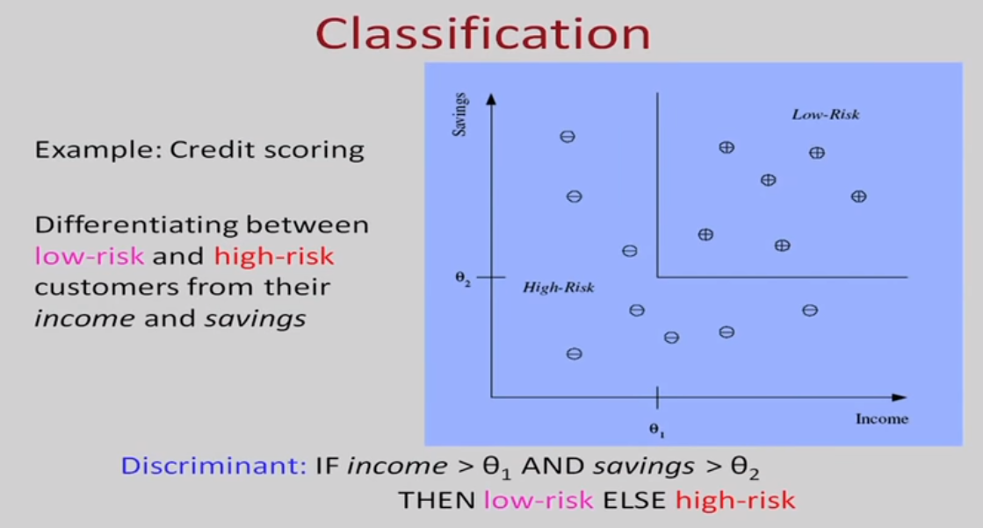
Classification Problem Example

Slide 23
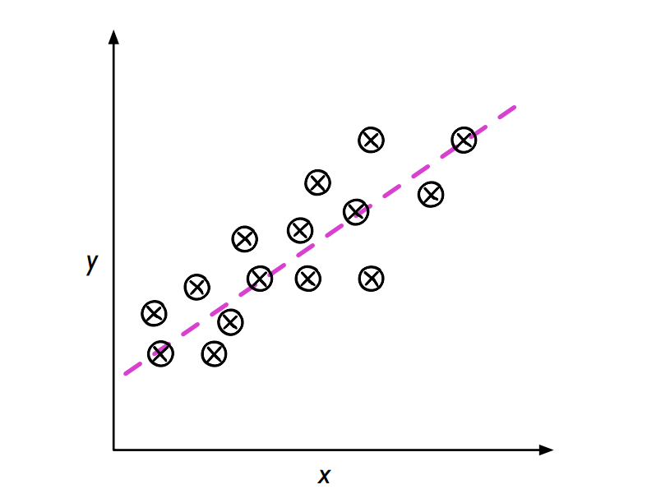
Regression
In regression analysis, the target values or labels are continuous variables.
Illustration of a linear regression model with one feature variable (x1) and the target
variable y. The dashed-line indicates the functional form of the linear regression model.

Slide 24
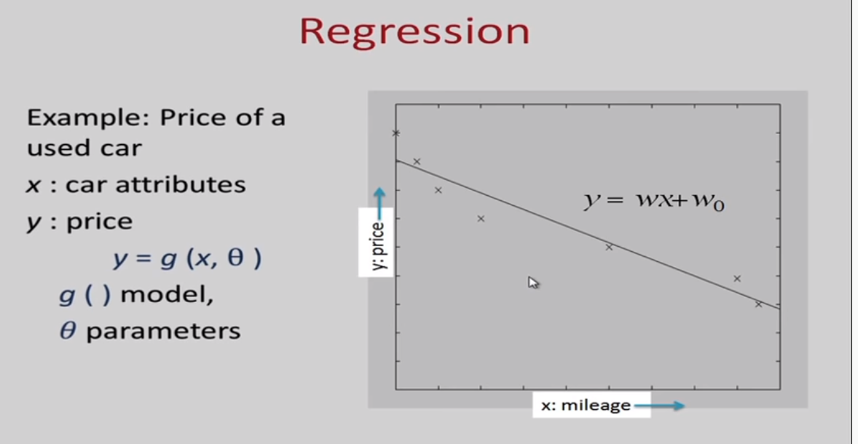
Simple Linear Regression

Slide 25
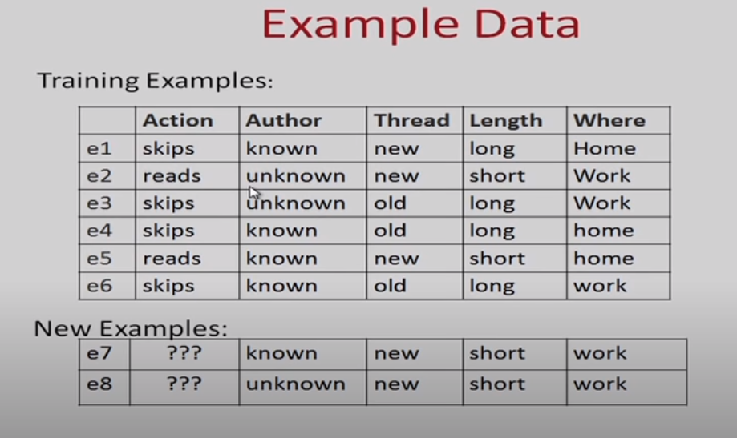
Example Dataset, which type of model you may apply on it??

Slide 26
2. Unsupervised Learning
Unsupervised learning involves training by using unlabeled data and allowing the model to act on that information without guidance.
Think of unsupervised learning as a smart kid that learns without any guidance. In this type of Machine Learning, the model is not fed with labeled data, as in the model has no clue that ‘this image is Tom and this is Jerry’, it figures out patterns and the differences between Tom and Jerry on its own by taking in tons of data.

Slide 27
Unsupervised Learning
No labels/targets No feedback
Find hidden structure in data

Slide 28
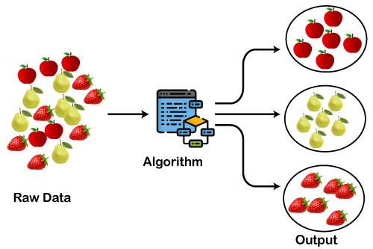
Cluster 1
Cluster 2
Cluster 3

Slide 29
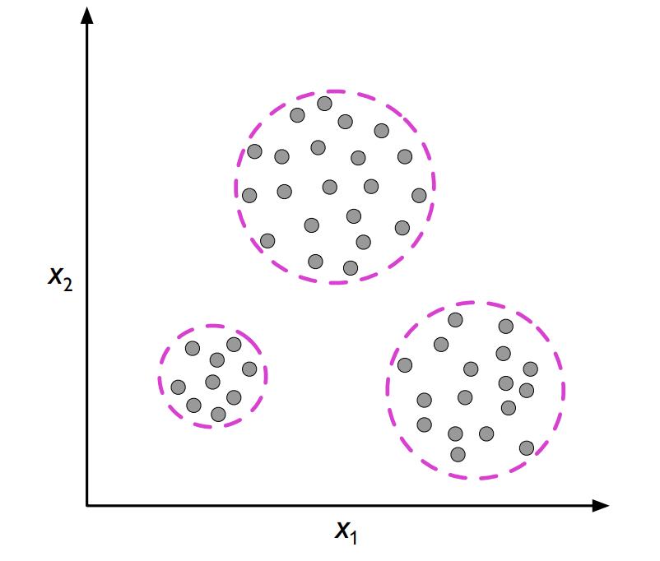
Unsupervised Learning
In contrast to supervised learning, unsupervised learning is a branch of machine learning that is concerned with unlabeled data. Common tasks in unsupervised learning are clustering analysis (assigning group memberships and dimensionality reduction (compressing data onto a lower-dimensional subspace or manifold).
Illustration of clustering, where the dashed lines indicate potential group membership assignments of unlabeled data points.

Slide 30
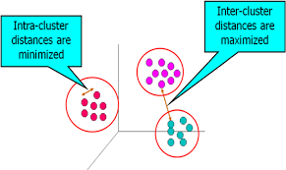

Slide 31
Categories of unsupervised learning
Clustering
Dimensionality Reduction

Slide 32
Clustering
A major subcategory of unsupervised learning is clustering, which assigns group membership information to data points. It can be thought of as a task similar to classification but without labeling information given in the training dataset. Hence, in the absence of class label information, the clustering approach is to group data records by similarity and define distinct groups based on similarity thresholds.
Clustering can be divided into three major groups: prototype-based, density-based, and hierarchical clustering. In prototype-based clustering algorithms, such as K-Means, a fixed number of cluster centers is defined (the cluster centers are repositioned iteratively), and data points are assigned to the closest prototype based on a pair-wise distance measure (for example, Euclidean distance). In density-based clustering, unlike in prototype-based clustering, the number of cluster centers is not fixed but assigned by identifying regions of high density (the location of many data records close to each other measured by a user-defined distance metric. In hierarchical clustering, a distance metric is used to group examples in a tree like-fashion, where examples at the root are more related to each other. The depth of the tree defines the number of clusters.

Slide 33
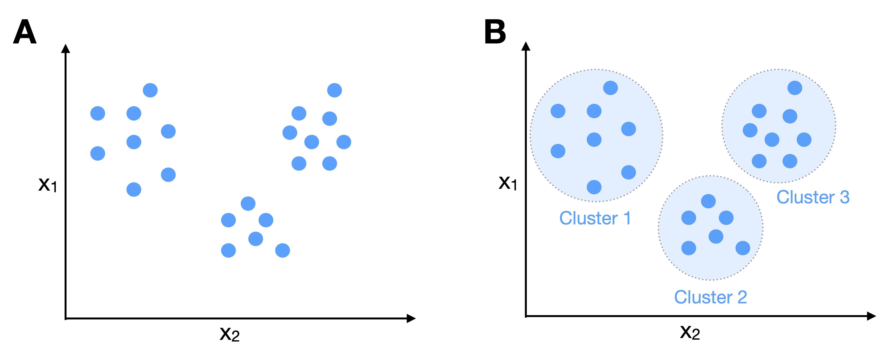
Illustration of clustering. (A) A two-dimensional, unlabeled dataset. (B) Clusters inferred by a clustering algorithm that groups similar points into the same cluster.

Slide 34
Dimensionality Reduction
One major subcategory of unsupervised learning is representation learning and dimensionality reduction. A popular and classic technique for this is principal component analysis (PCA)
In a nutshell, PCA identifies the directions of maximum variance in a dataset. These directions (eigenvectors of the covariance matrix) form the principal component axes of a new coordinate system. In practice, PCA is typically used to reduce the dimensionality of a dataset while retaining most of its information (variance). PCA is a linear transformation technique. Thus, it cannot capture complex non-linear patterns in data; however, kernel PCA and other non-linear dimensionality reduction techniques exist.

Slide 35
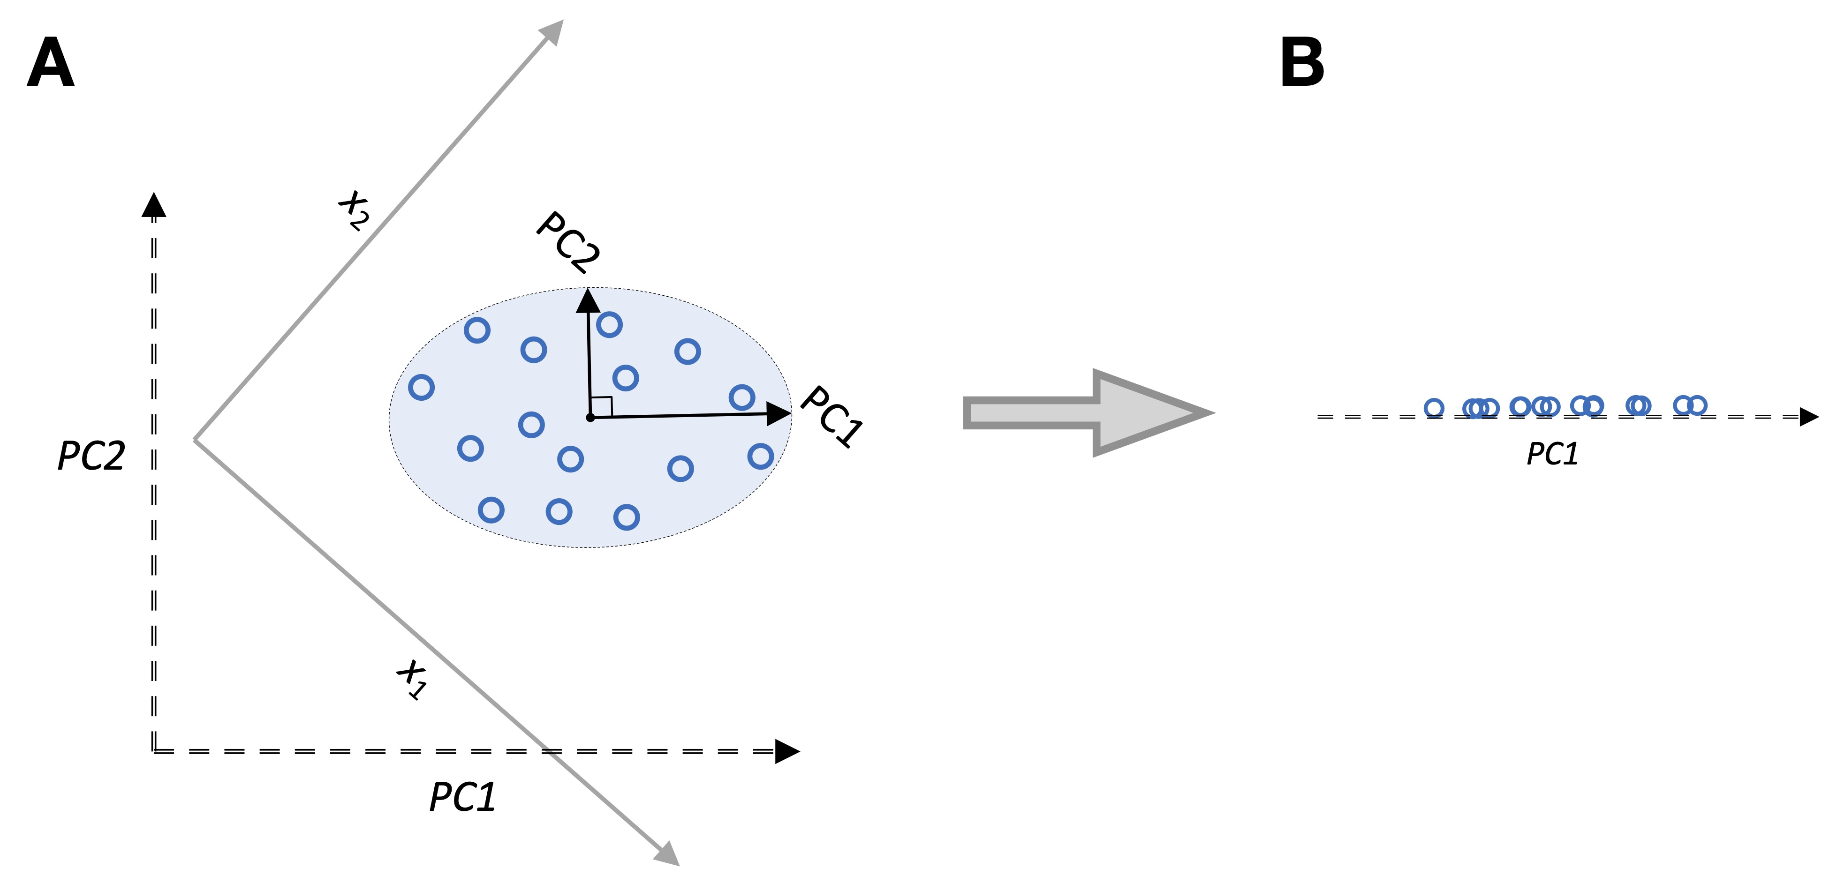
PCA
Illustrations of PCA. (A) A dataset (blue circles) with two feature axis x1 and x2 that has been projected onto the principal components PC1 and PC2
(B) A view of the data projected onto the first principal component (PC1).

Slide 36
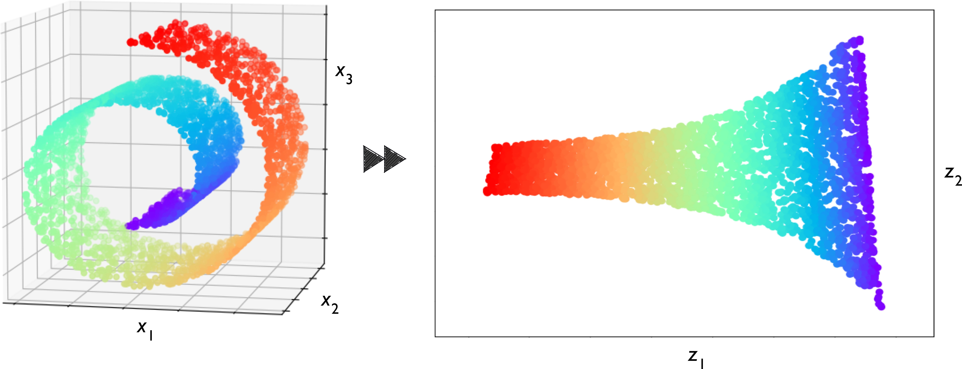
Unsupervised Learning
-- Dimensionality Reduction

Slide 37
Applications of Unsupervised learning
AirBnB – This is a great application which helps host stays and experiences connecting people all over the world. This application uses Unsupervised Learning where the user queries his or her requirements and Airbnb learns these patterns and recommends stays and experiences which fall under the same group or cluster.
Amazon – Amazon also uses unsupervised learning to learn the customer’s purchase and recommend the products which are most frequently bought together which is an example of association rule mining.
Credit-Card Fraud Detection – Unsupervised Learning algorithms learn about various patterns of the user and their usage of the credit card. If the card is used in parts that do not match the behavior, an alarm is generated which could possibly be marked fraud and calls are given to you to confirm whether it was you using the card or not.

Slide 38
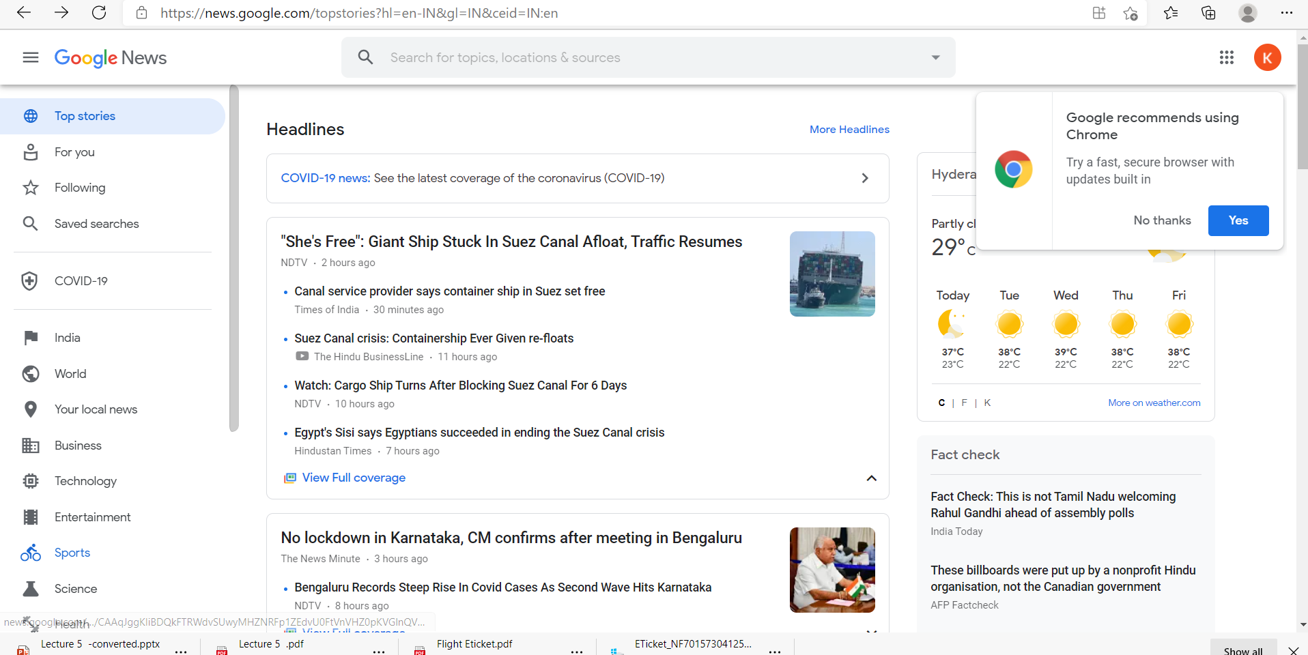
Grouping of news-Let’s understand clustering further with an example of google news.
What google news does is that every day with hundreds and thousands of news coming up on the web, it groups them into cohesive news stories. Let’s see how?
Once you go to news.google.com, you will see numerous news stories grouped as shown below.

Slide 39
Customer Segmentation
Retail and Marketing: Businesses use clustering to segment their customers into distinct groups based on purchasing behavior, demographics, or preferences. This allows for targeted marketing campaigns, personalized offers, and better customer service.
Example: An e-commerce company might cluster customers based on their purchase history, enabling personalized recommendations and targeted promotions.

Slide 40
Document and Text Analysis
Topic Modeling: Clustering algorithms like Latent Dirichlet Allocation (LDA) group documents into topics based on the words they contain. This helps in summarizing large collections of documents or news articles.
Example: Search engines use clustering to organize search results into different topics, making it easier for users to find relevant information.
Spam Filtering: Clustering can be used to group similar emails and identify patterns associated with spam messages.

Slide 41
Anomaly Detection
Fraud Detection: In financial institutions, clustering is used to detect unusual patterns in transaction data that might indicate fraudulent activity.
Example: Credit card companies use clustering to identify suspicious transactions that deviate from a customer's usual spending behavior.
Network Security: Clustering helps in detecting unusual patterns of network traffic that could indicate a cyber attack.

Slide 42
Recommendation Systems
Content-based and Collaborative Filtering: Clustering can be used to group similar users or items, which is then used to make recommendations based on the preferences of users within the same cluster.
Example: Streaming services like Netflix use clustering to recommend movies or TV shows by grouping users with similar viewing habits.
Healthcare
Patient Segmentation: Clustering helps in grouping patients with similar symptoms or medical histories, which can aid in diagnosing diseases, predicting outcomes, and personalizing treatments.
Example: Clustering can be used to segment patients with diabetes into different groups based on their risk factors, allowing for tailored treatment plans.
Epidemiology: Clustering is used to identify patterns in the spread of diseases, which can help in understanding transmission dynamics and planning public health interventions.

Slide 43
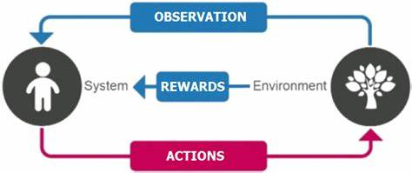
Reinforcement Learning
Reinforcement Learning is a part of Machine learning where an agent is put in an environment and he learns to behave in this environment by performing certain actions and observing the rewards which it gets from those actions.

Slide 44
Reinforcement is the process of learning from rewards while performing a series of actions. In reinforcement learning, we do not tell the learner or agent (for example, a robot), which action to take but merely assign a reward to each action and/or the overall outcome. Instead of having “correct/false” labels for each step, the learner must discover or learn a behavior that maximizes the reward for a series of actions. In that sense, it is not a supervised setting. RL is somewhat related to unsupervised learning; however, reinforcement learning really is its own category of machine learning. Typical applications of reinforcement learning involve playing games (chess, Go, Atari video games) and some form of robots, e.g., drones, warehouse robots, and more recently self- driving cars

Slide 45
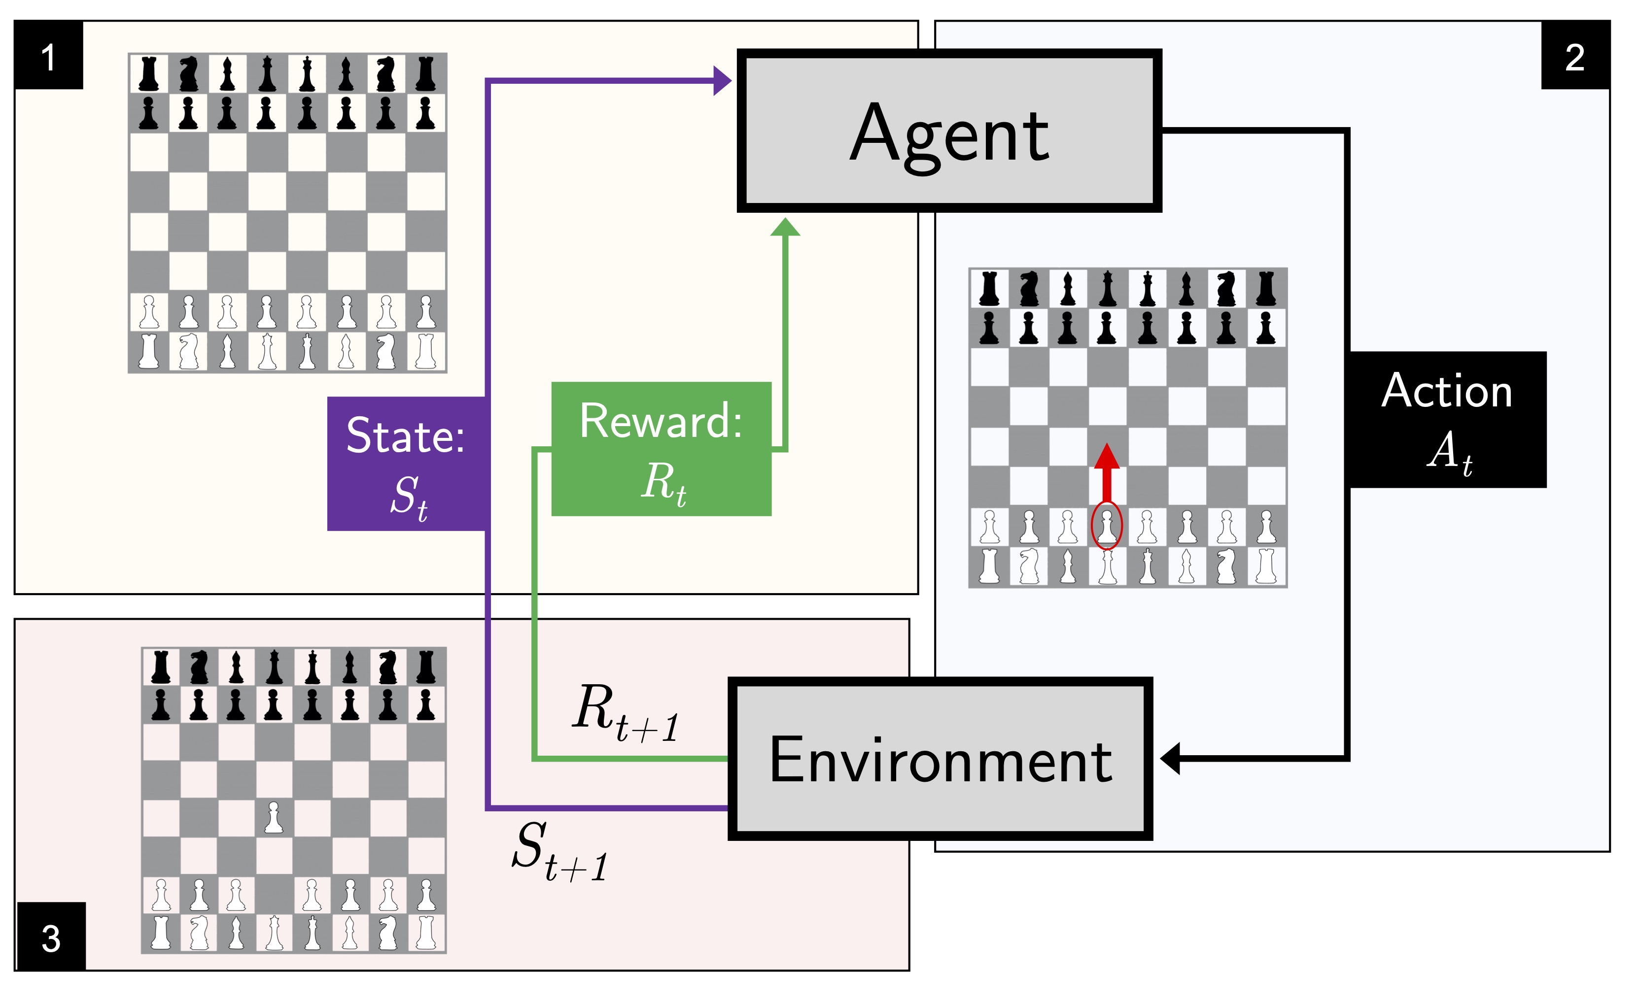
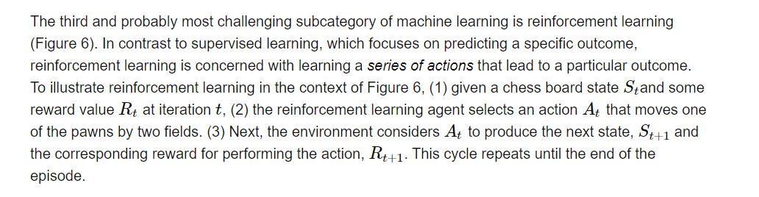

Slide 46
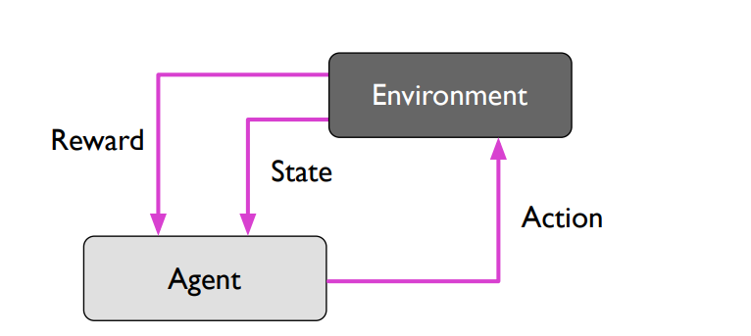
Illustration of reinforcement learning

Slide 47
This type of Machine Learning is comparatively different. Imagine that you were dropped off at an isolated island! What would you do?
Panic? Yes, of course, initially we all would. But as time passes by, you will learn how to live on the island. You will explore the environment, understand the climate condition, the type of food that grows there, the dangers of the island, etc. This is exactly how Reinforcement Learning works, it involves an Agent (you, stuck on the island) that is put in an unknown environment (island), where he must learn by observing and performing actions that result in rewards.
Reinforcement Learning is mainly used in advanced Machine Learning areas such as self-driving cars, AplhaGo, etc.

Slide 48
Another example to understand Reinforcement Learning
Let's consider a teenage kid who is trying to learn how to drive for the first time. He pushes the accelerator pedal and realized that the car moves when you push that. The moving car makes him happy and that's a reward. The car is stationary and the kid pushes the brake pedal and the car does not move, he gets sad and that is not considered a reward. Now the kid accelerates and then pushes the brake pedal and realized what's actually happening and again that's a reward.

Slide 49
Terminology used in Reinforcement Learning Process
Agent-The RL algorithm that learns from trial and error
Environment- The world through which the agent interacts
Action- All possible steps that the agent can take
State- Current condition returned by the environment
Reward- An instant return from the environment to appraise the last action.
Policy- The approach the agent uses to determine the next action on the current state
Reward Maximization-The RL agent should be trained in such a way that he takes the best action towards its goal

Slide 50
Terminology used in Reinforcement Learning Process
Exploitation- It is about using the already known exploited information to increase the rewards.
Exploration-It is about exploring and capturing more information about an environment

Slide 51
Applications of Reinforcement learning
Reinforcement Learning in self-driving cars:Various papers have proposed Deep Reinforcement Learning for autonomous driving. In self-driving cars, there are various aspects to consider, such as speed limits at various places, drivable zones, avoiding collisions — just to mention a few. Some of the autonomous driving tasks where reinforcement learning could be applied include trajectory optimization, motion planning, dynamic pathing, controller optimization, and scenario-based learning policies for highways.

Slide 52
Reinforcement Learning in robotics manipulation: The use of deep learning and reinforcement learning can train robots that have the ability to grasp various objects — even those unseen during training. This can, for example, be used in building products in an assembly line.

Slide 53
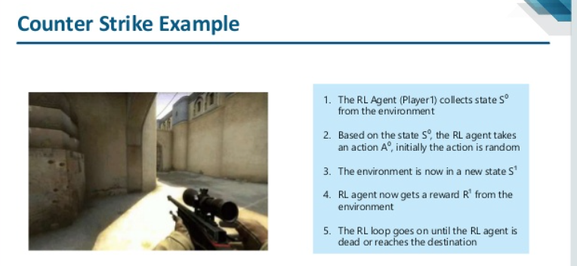
Applications of Reinforcement learning

Slide 54
Additional learning technique
Semi-supervised learning
Loosely speaking, semi-supervised learning can be described as a mix between supervised and unsupervised learning. In semi-supervised learning tasks, some training examples contain outputs, but some do not. We then use the labeled training subset to label the unlabeled portion of the training set, which we then also utilize for model training.

Slide 55
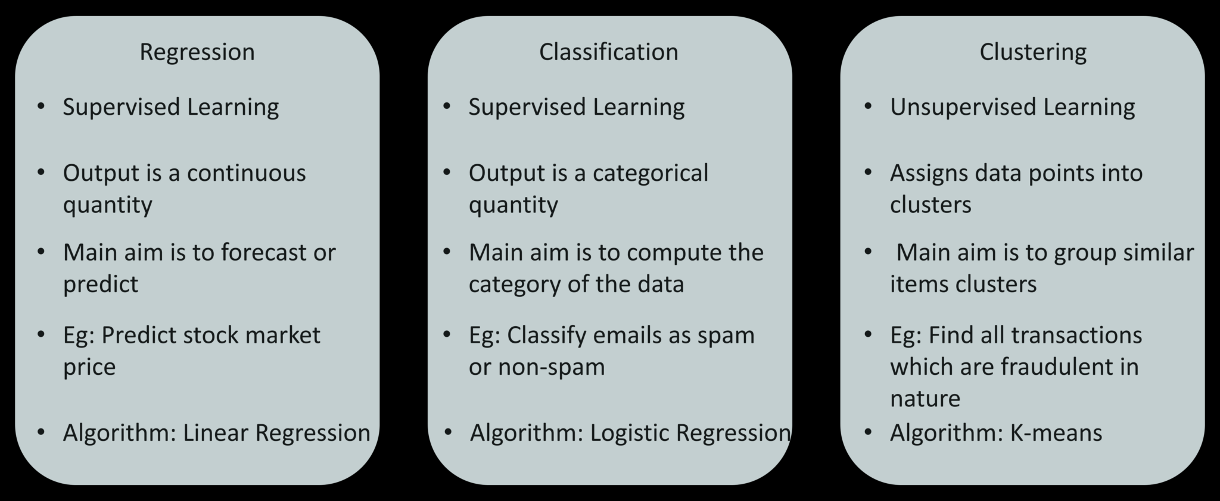

Slide 56
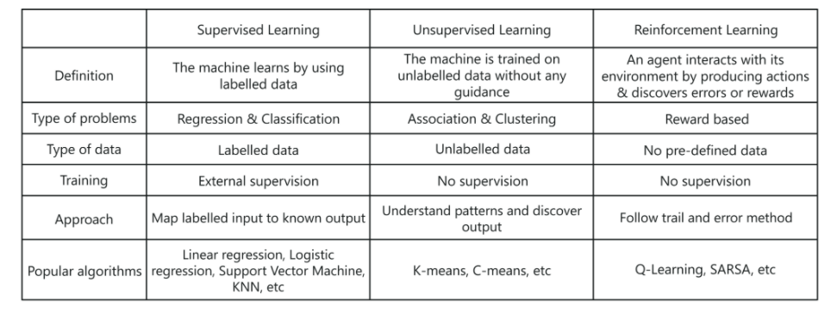
Difference between different learning types
Notes:
Association is a data mining function that discovers the probability of the co-occurrence of items in a collection. The relationships between co-occurring items are expressed as association rules. Association rules are often used to analyze sales transactions.

